Slide 1
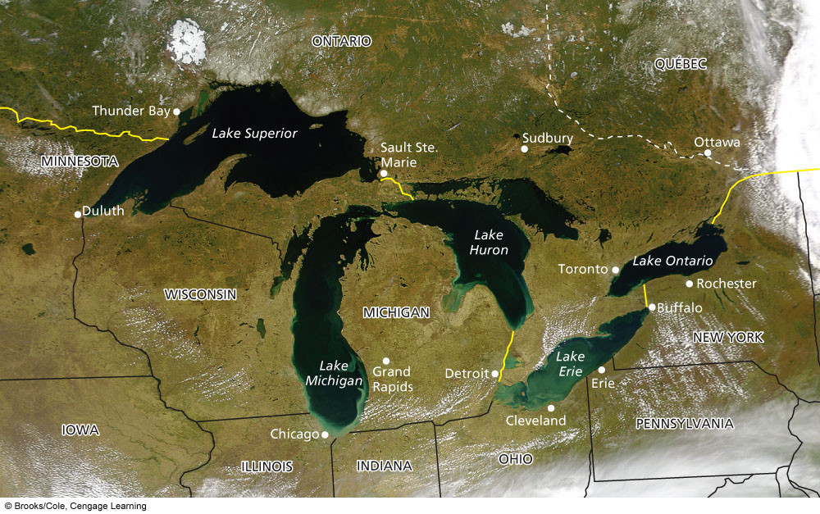
Water Pollution
Dr. Praveen Kumar
Assistant Professor
Department of Zoloogy
D. N. College, Meerut

Slide 2
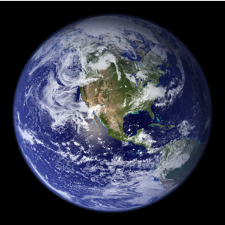
Water makes us unique and gives life to Earth.

Slide 3
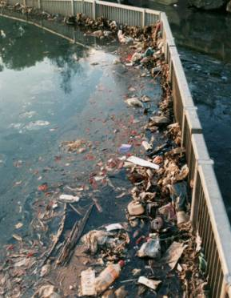
What is water pollution?
Any chemical, biological, or physical change in water quality that has a harmful effect on living organisms or makes water unsuitable for desired usage.

Slide 4
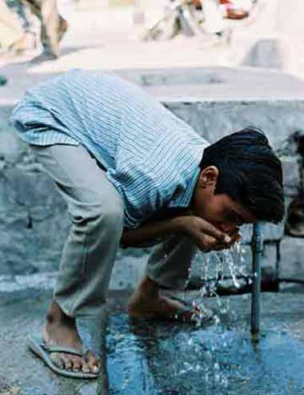
What is water pollution?
WHO:
3.4 million premature deaths each year from waterborne diseases
1.9 million from diarrhea
U.S. 1.5 million illnesses
Lack of water, sanitation, and hygiene results in the loss of 0.4 million people annually in India (WHO 2007).

Slide 5
What is water pollution?
WHO:
3.4 million premature deaths each year from waterborne diseases
1.9 million from diarrhea
U.S. 1.5 million illnesses
Lack of water, sanitation, and hygiene results in the loss of 0.4 million people annually in India (WHO 2007).

Slide 6
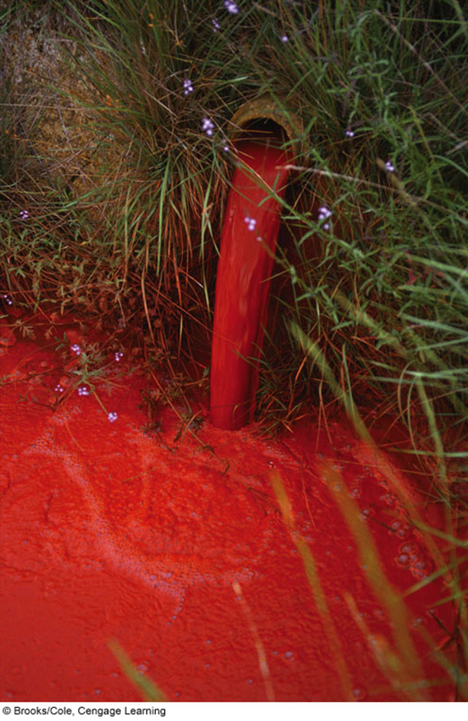
Sources of water pollution
Point sources
  Located at specific places
  Easy to identify, monitor, and regulate
  Examples

Slide 7
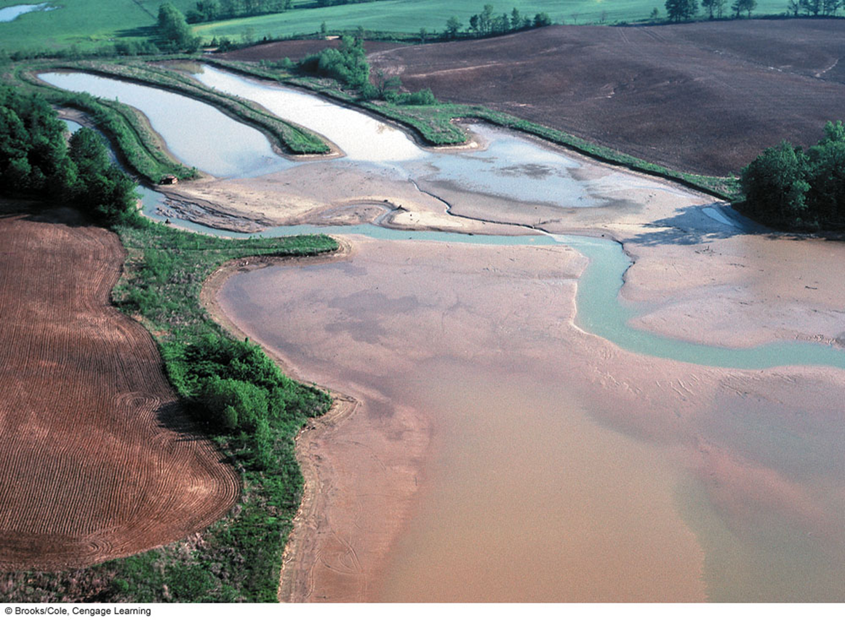
Sources of water pollution
Nonpoint sources
  Broad, diffuse areas
  Difficult to identify and control
  Expensive to clean up
  Examples

Slide 8
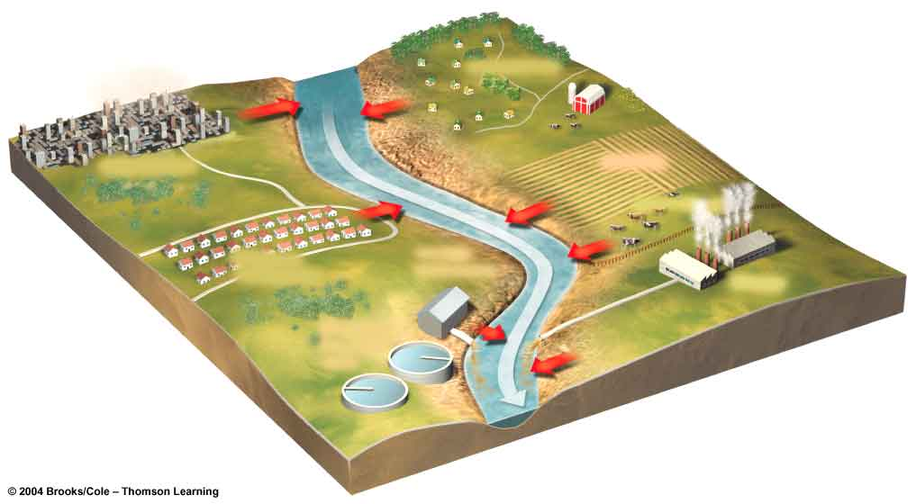
Point and Nonpoint Sources
NONPOINT SOURCES
Rural homes
Urban streets
Cropland
Animal feedlot
Suburban development
POINT SOURCES
Factory
Wastewater treatment plant

Slide 9
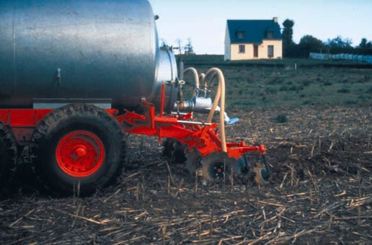
Major Sources of Water Pollution
Agriculture: by far the leader
Sediment, fertilizers, bacteria from livestock, food processing, salt from soil irrigation
Industrial: factories and power plants
Mining: surface mining toxics, acids, sediment

Slide 10
Major water pollutant
Infectious Agents: bacteria and viruses often from animal wastes
Oxygen Demanding Wastes: organic waste that needs oxygen often from animal waste, paper mills and food processing.
Inorganic Chemicals: Acids and toxic chemicals often from runoff, industries and household cleaners
Organic Chemicals: oil, gasoline, plastics, detergents often from surface runoff, industries and cleaners
Plant Nutrients: water soluble nitrates, ammonia and phosphates often from sewage, agriculture and urban fertilizers
Sediment: soils and silts from land erosion can disrupt photosynthesis, destroy spawning grounds, clog rivers and streams
Heat Pollution and Radioactivity: mostly from power plants

Slide 11
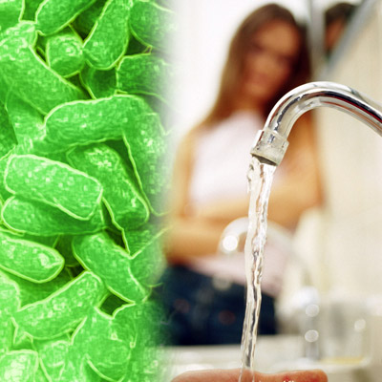
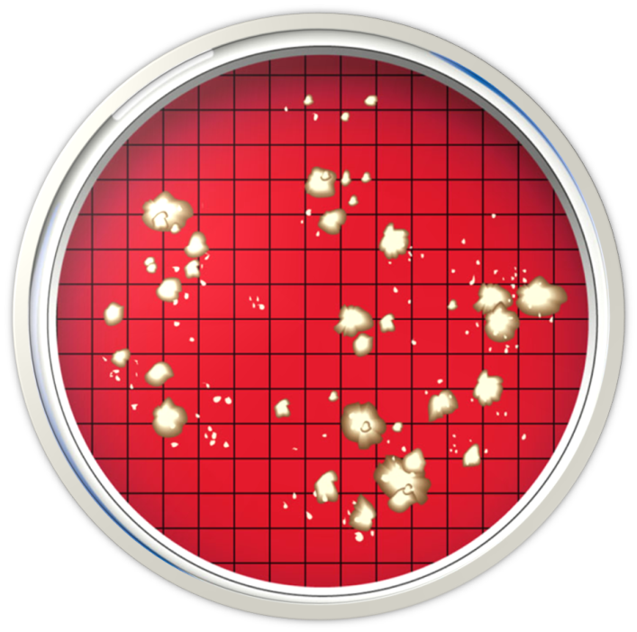
How do we measure water quality
Bacterial Counts: Fecal coliform counts from intestines of animals
None per 100 ml for drinking
>200 per 100 ml for swimming
Sources: human sewage, animals, birds, raccoons, etc.

Slide 12
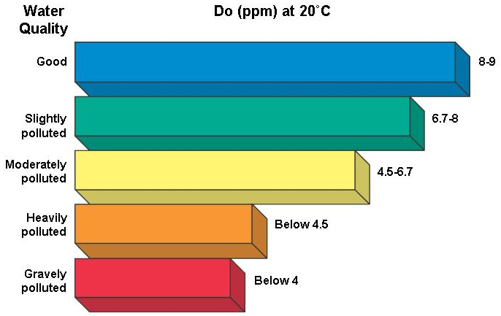
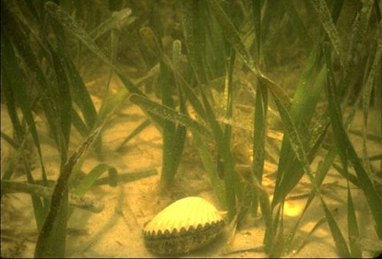
How do we measure water quality
Dissolved Oxygen: BOD Biological Oxygen Demand…the amount of oxygen consumed by aquatic decomposers
Chemical Analysis: looking for presence of inorganic or organic chemicals
Suspended Sediment water clarity
Indicator Species: organisms that give an idea of the health of the water body.
Mussels, oysters and clams filter water

Slide 13
Pollution in streams and lakes
Freshwater pollution: What are major problems in streams?
Developed versus Developing Countries
Lake Pollution: Lakes and reservoirs more vulnerable
Eutrophication

Slide 14
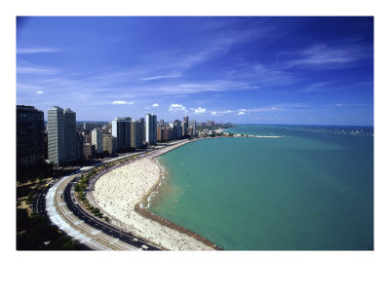
Lakes Pollution
Lake Pollution: Lakes and reservoirs more vulnerable
Dilution as a solution in lakes less effective
Little vertical mixing
Little water flow (flushing)
Makes them more vulnerable
Toxins settle
Kill bottom life
Atmospheric deposition
Food chain disruptions

Slide 15
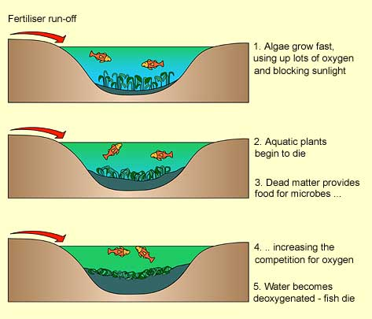
Eutrophication of Lakes
Eutrophication: nutrient enrichment of lakes mostly from runoff of plant nutrients (nitrates and phosphates)
During hot dry weather can lead to algae blooms
Decrease of photosynthesis
Dying algae then drops DO levels
Fish kills, bad odor

Slide 16
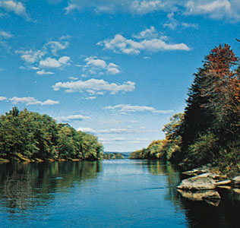
Freshwater Stream Pollution
Flowing streams can recover from moderate level of degradable water pollution if their flows are not reduced.
Natural biodegradation process
Does not work if overloaded or stream flow reduced
Does not work against non biodegradable pollutants

Slide 17
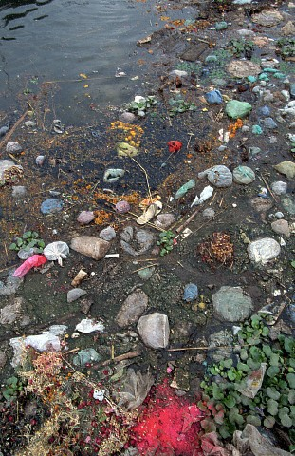
India’s Ganges River
Holy River (1 million take daily holy dip)
350 million (1/3rd of pop) live in watershed
Little sewage treatment
Used for bathing, drinking etc.
Bodies (cremated or not) thrown in river
Good news is the Indian government is beginning to work on problem

Slide 18
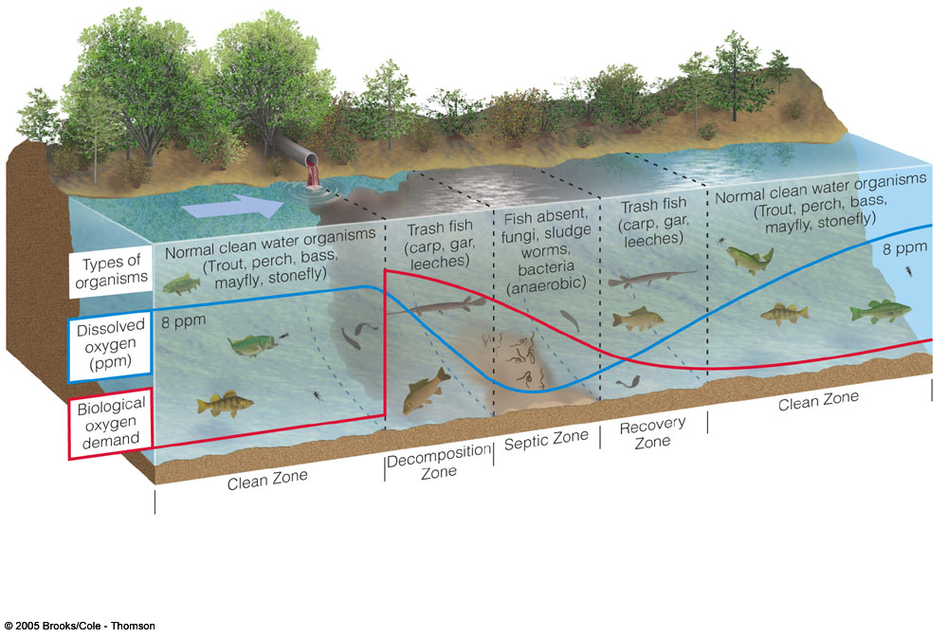
Pollution of Streams
Oxygen sag curve
Factors influencing recovery
What factors will influence this oxygen sag curve?

Slide 19
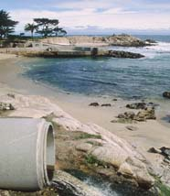
Ocean Pollution
Oceans can disperse and break down large quantities of degradable pollution if they are not overloaded.
Pollution worst near heavily populated coastal zones
Wetlands, estuaries, coral reefs, mangrove swamps
40% of world’s pop. Live within 62 miles of coast

Slide 20
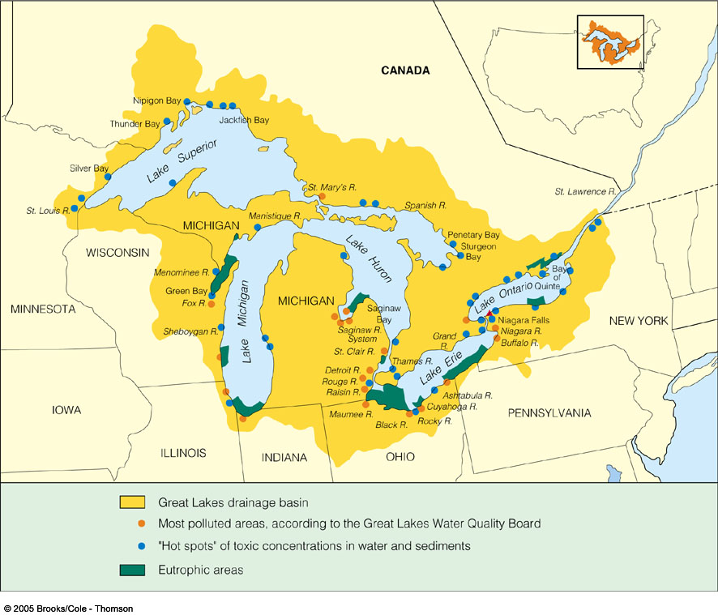
Case Study: The Great Lakes
Pollution levels dropped, but long way to go
95% of U.S. freshwater
30% Canadian pop, 14% U.S.
38 million drink
1% flow out St. Lawrence
Toxic fish

Slide 21
Case Study: Pollution in the Great
Lakes (1)
1960s: Many areas with cultural eutrophication
1972: Canada and the United States: Great Lakes pollution control program
Problems still exist
  Raw sewage
  Nonpoint runoff of pesticides and fertilizers
  Biological pollution
  Atmospheric deposition of pesticides and Hg

Slide 22
Case Study: Pollution in the Great
Lakes (2)
2007 State of the Great Lakes report
  New pollutants found
  Wetland loss and degradation; significance?
  Declining of some native species
  Native carnivorous fish species declining

Slide 23
Indian scenario
Groundwater contamination—a problem which has affected as many as 19 states, including Delhi.
During 1995–2009, the number of observed sample with BOD values less than 3 mg/l were between 57–69 percent;
In 2007 the observed samples were 69 per cent.
Similarly, during this period of 15 years between 17–28 percent of the samples observed BOD value between 3-6 mg/l and the maximum number of samples in this category were observed in 1998.

Slide 24
Indian scenario

Slide 25
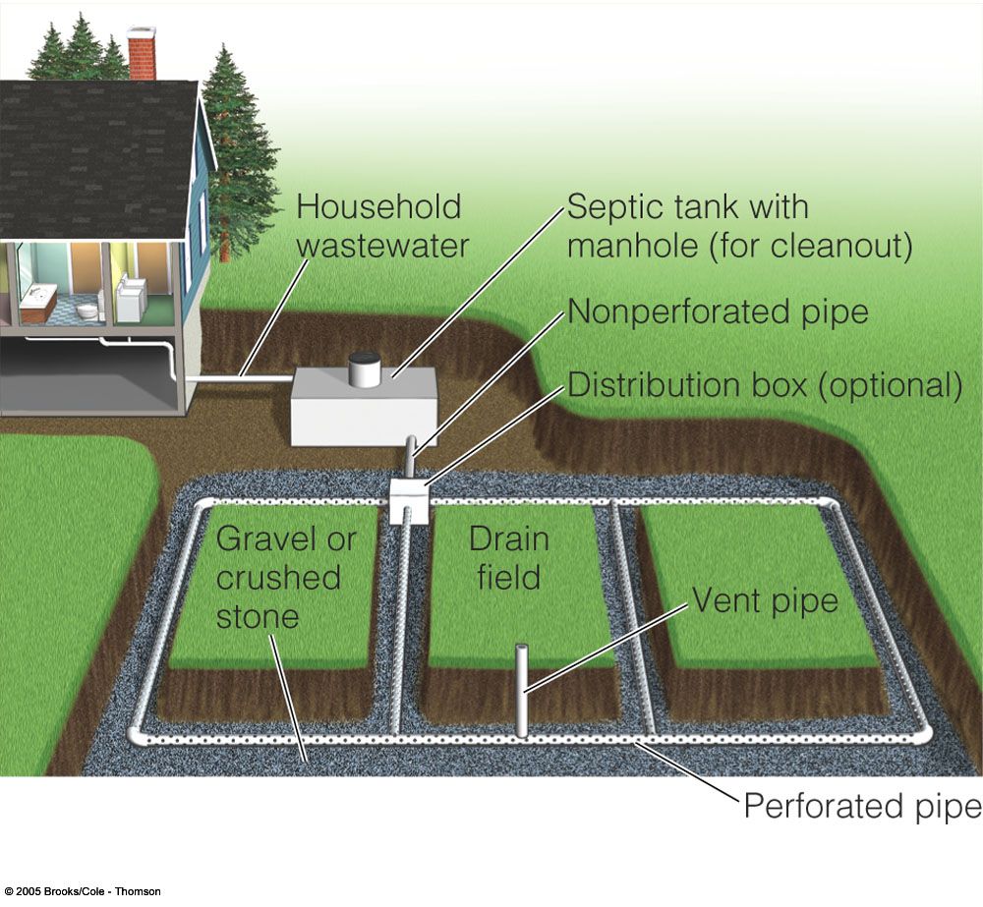
Technological Approach: Septic Systems
Require suitable soils and maintenance
¼ of all U.S. homes have Septic tanks
Can be used in parking lots, business parks, etc.
Fig. 22-15 p. 510

Slide 26
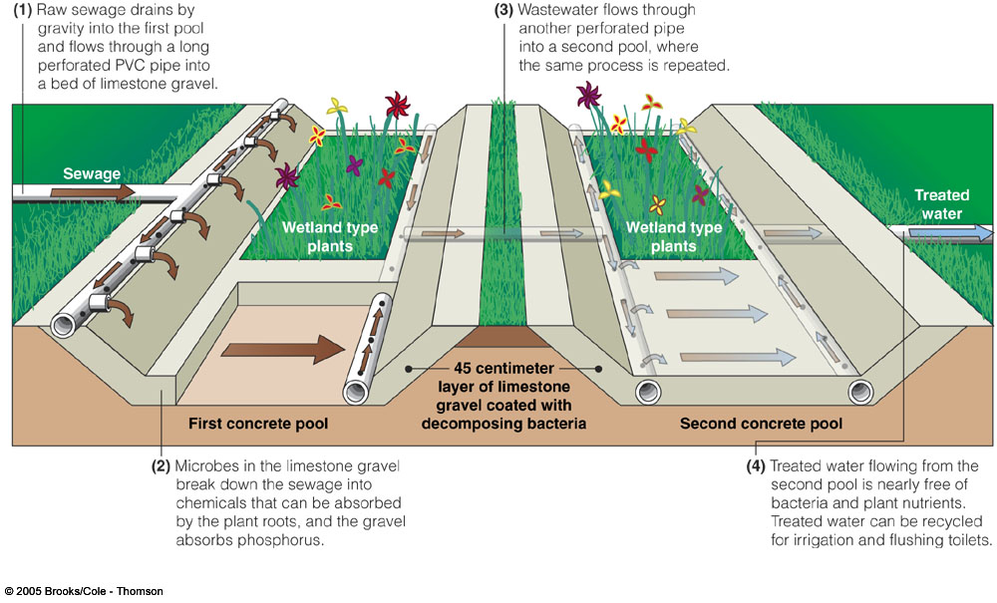
Construction of wet lands

Slide 27
